Slide 1
CSE4421/5324: Introduction to Robotics

Slide 2
Contact Information
Burton Ma
Lassonde 2046
burton@cse.yorku.ca
EECS4421/5324
lectures Monday, Wednesday, Friday 2:30-3:30PM (CB 122)
labs Thursday 11:30-1:30, Prism 1004
www.eecs.yorku.ca/course/4421
(web site not complete yet)

Slide 3
General Course Information
introduces the basic concepts of robotic manipulators and autonomous systems. After a review of some fundamental mathematics the course examines the mechanics and dynamics of robot arms, mobile robots, their sensors and algorithms for controlling them.
one robotic arm (hopefully)
everything in Matlab
other references
  see course web page

Slide 4
Labs
six 2-hour labs
  Thursday 11:30-1:30 in Prism LAS1004
  different lab sections alternate between weeks
    except possibly for Lab 01
  first part of Lab 01 already posted and must be completed prior to lab

Slide 5
Assessment
labs/assignments 6 x 5%
midterm, 30%
exam, 40%

Slide 6
Day 01
Introduction to manipulator kinematics

Slide 7
Robotic Manipulators
a robotic manipulator is a kinematic chain
  i.e. an assembly of pairs of rigid bodies that can move respect to one another via a mechanical constraint
the rigid bodies are called links
the mechanical constraints are called joints

Slide 8
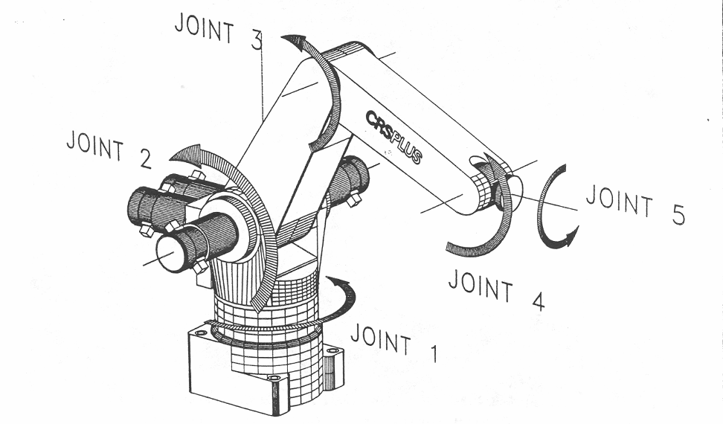
A150 Robotic Arm
link 3
link 2

Slide 9
Joints
most manipulator joints are one of two types
revolute (or rotary)
  like a hinge
  allows relative rotation about a fixed axis between two links
    axis of rotation is the z axis by convention
prismatic (or linear)
  like a piston
  allows relative translation along a fixed axis between two links
    axis of translation is the z axis by convention
our convention: joint i connects link i – 1 to link i
  when joint i is actuated, link i moves

Slide 10
Joint Variables
revolute and prismatic joints are one degree of freedom (DOF) joints; thus, they can be described using a single numeric value called a joint variable
q_{i} : joint variable for joint i
revolute
  q_{i} = θ_{i} : angle of rotation of link i relative to link i – 1
prismatic
  q_{i} = d_{i} : displacement of link i relative to link i – 1

Slide 11
Revolute Joint Variable
revolute
  q_{i} = θ_{i} : angle of rotation of link i relative to link i – 1
link i
θ_{i}
link i – 1

Slide 12
Prismatic Joint Variable
prismatic
  q_{i} = d_{i} : displacement of link i relative to link i – 1
link i – 1
link i
d_{i}

Slide 13
Common Manipulator Arrangments
most industrial manipulators have six or fewer joints
  the first three joints are the arm
  the remaining joints are the wrist
it is common to describe such manipulators using the joints of the arm
  R: revolute joint
  P: prismatic joint

Slide 14
Articulated Manipulator
RRR (first three joints are all revolute)
joint axes
  z₀ : waist
  z₁ : shoulder (perpendicular to z₀)
  z₂ : elbow (parallel to z₁)
z₀
z₁
z₂
θ₂
θ₃
shoulder
forearm
elbow
θ₁
waist

Slide 15
Spherical Manipulator
RRP
Stanford arm
  http://infolab.stanford.edu/pub/voy/museum/pictures/display/robots/IMG_2404ArmFrontPeekingOut.JPG
z₀
z₁
d₃
θ₂
shoulder
z₂
θ₁
waist

Slide 16
SCARA Manipulator
RRP
Selective Compliant Articulated Robot for Assembly
  http://www.robots.epson.com/products/g-series.htm
z₁
z₂
z₀
θ₂
d₃
θ₁

Slide 17
Forward Kinematics
given the joint variables and dimensions of the links what is the position and orientation of the end effector?
a₂
θ₂
a₁
θ₁

Slide 18
Forward Kinematics
choose the base coordinate frame of the robot
  we want (x, y) to be expressed in this frame
(x, y) ?
a₂
θ₂
y₀
a₁
θ₁
x₀

Slide 19
Forward Kinematics
notice that link 1 moves in a circle centered on the base frame origin
(x, y) ?
a₂
θ₂
y₀
a₁
θ₁
( a₁ cos θ₁ , a₁ sin θ₁ )
x₀

Slide 20
Forward Kinematics
choose a coordinate frame with origin located on joint 2 with the same orientation as the base frame
(x, y) ?
y₁
a₂
θ₂
y₀
θ₁
a₁
x₁
θ₁
( a₁ cos θ₁ , a₁ sin θ₁ )
x₀

Slide 21
Forward Kinematics
notice that link 2 moves in a circle centered on frame 1
(x, y) ?
y₁
a₂
( a₂ cos (θ₁ + θ₂),
a₂ sin (θ₁ + θ₂) )
θ₂
y₀
θ₁
a₁
x₁
θ₁
( a₁ cos θ₁ , a₁ sin θ₁ )
x₀

Slide 22
Forward Kinematics
because the base frame and frame 1 have the same orientation, we can sum the coordinates to find the position of the end effector in the base frame
(a₁ cos θ₁ + a₂ cos (θ₁ + θ₂),
a₁ sin θ₁ + a₂ sin (θ₁ + θ₂) )
y₁
a₂
( a₂ cos (θ₁ + θ₂),
a₂ sin (θ₁ + θ₂) )
θ₂
y₀
θ₁
a₁
x₁
θ₁
( a₁ cos θ₁ , a₁ sin θ₁ )
x₀

Slide 23
Forward Kinematics
we also want the orientation of frame 2 with respect to the base frame
  x₂ and y₂ expressed in terms
  of x₀ and y₀
y₂
x₂
a₂
θ₂
y₀
θ₁
a₁
θ₁
x₀

Slide 24
Forward Kinematics
without proof I claim:
x₂ = (cos (θ₁ + θ₂),
sin (θ₁ + θ₂) )
y₂
x₂
y₂ = (-sin (θ₁ + θ₂),
cos (θ₁ + θ₂) )
a₂
θ₂
y₀
θ₁
a₁
θ₁
x₀

Slide 25

Forward Kinematics
find $\left(x,y\right)$, $x_{2}$, and $y_{2}$ expressed in frame $0$
y₂
y₀
y₁
x₂
(x, y) ?
d₁
θ₂
x₀
x₁

Slide 26

Forward Kinematics
find $\left(x,y\right)$, $x_{2}$, and $y_{2}$ expressed in frame $0$
y₂
y₁
x₂
(x, y) ?
d₁
θ₂
y₀
x₁
$$30°$$
x₀

Slide 27
Inverse Kinematics
given the position (and possibly
the orientation) of the end
effector, and the dimensions
of the links, what are the joint
variables?
y₂
x₂
(x, y)
a₂
θ₂ ?
y₀
a₁
θ₁ ?
x₀

Slide 28
Inverse Kinematics
harder than forward kinematics because there is often more than one possible solution
(x, y)
a₂
y₀
a₁
x₀

Slide 29
Inverse Kinematics
law of cosines
(x, y)
a₂
b
θ₂ ?
y₀
a₁
x₀

Slide 30
Inverse Kinematics
and we have the trigonometric identity
therefore,
We could take the inverse cosine, but this gives only one of the two solutions.

Slide 31
Inverse Kinematics
Instead, use the two trigonometric identities:
to obtain
which yields both solutions for θ₂ . In many programming languages you would use the
four quadrant inverse tangent function atan2
c2 = (x*x + y*y – a1*a1 – a2*a2) / (2*a1*a2);
s2 = sqrt(1 – c2*c2);
theta21 = atan2(s2, c2);
theta22 = atan2(-s2, c2);

Slide 32
Inverse Kinematics
Exercise for the student: show that

